Slide 1
Lecture 7

Slide 2
a disordered sample can be considered as a random chain of effective resonant microcavities
parameters of these cavities can be retrieved from the measurements of the transmission and reflection

Slide 3
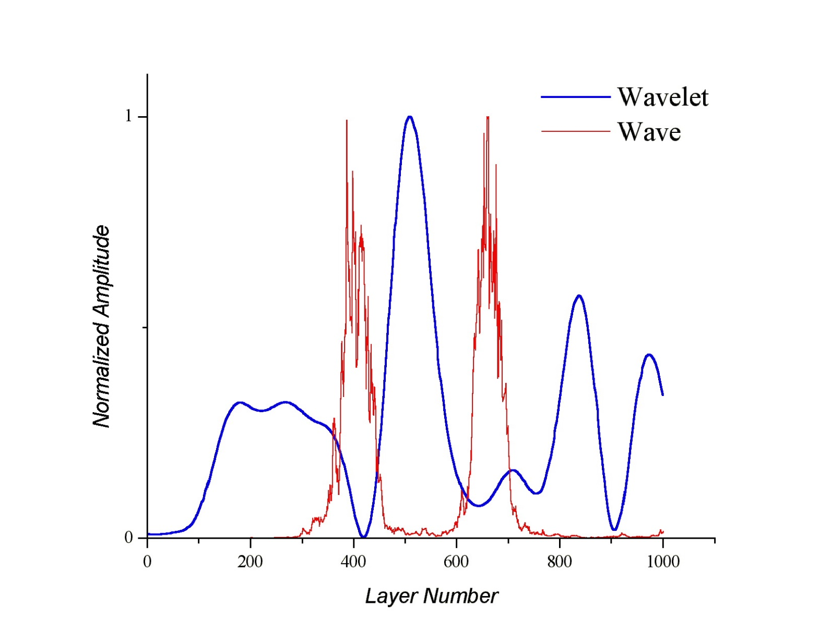

Slide 4
coupling vs. loss

Slide 5
small losses, strong coupling:
frequency gap
levels repulsion
large losses, weak coupling:
frequencies merge; levels crossing at

Slide 7
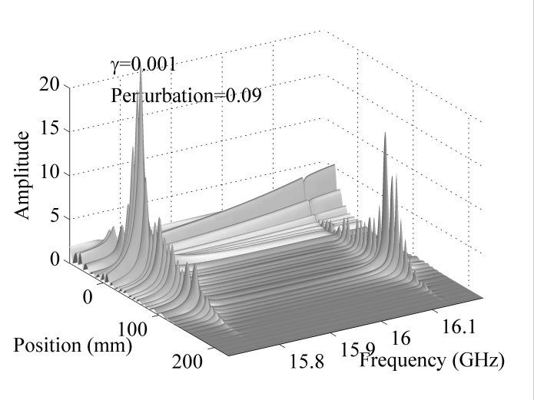
Coupling of localized states
Notes:
7

Slide 8
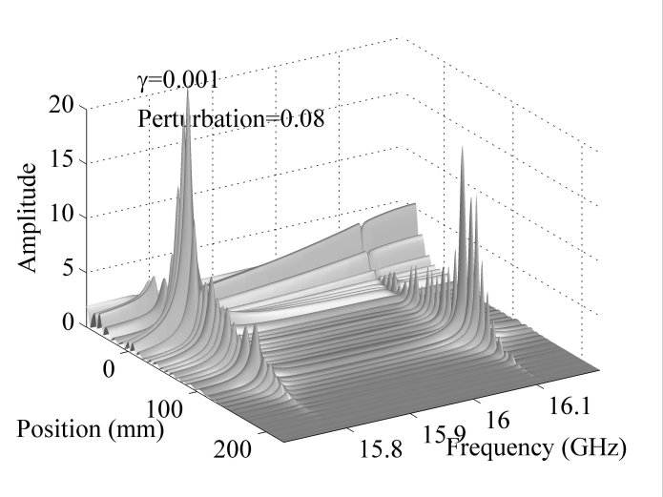
Notes:
8

Slide 9
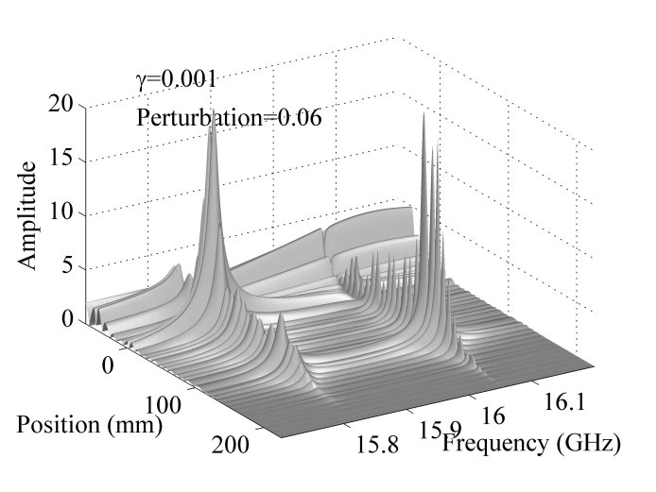
Notes:
9

Slide 10
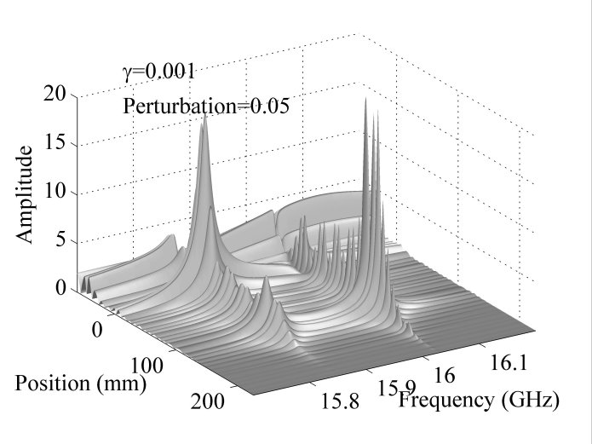
Notes:
10

Slide 11
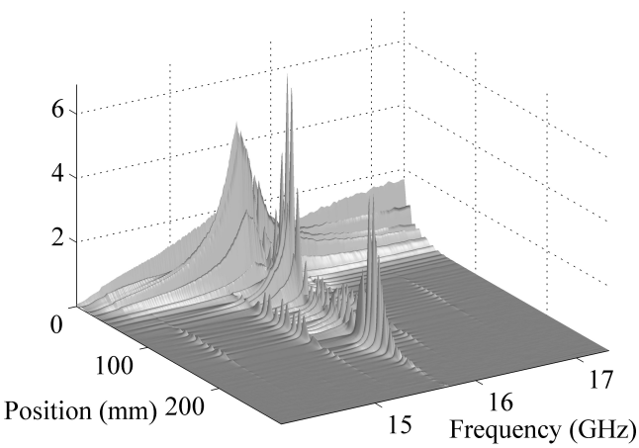
Notes:
11

Slide 12
EXPERIMENTS

Slide 13
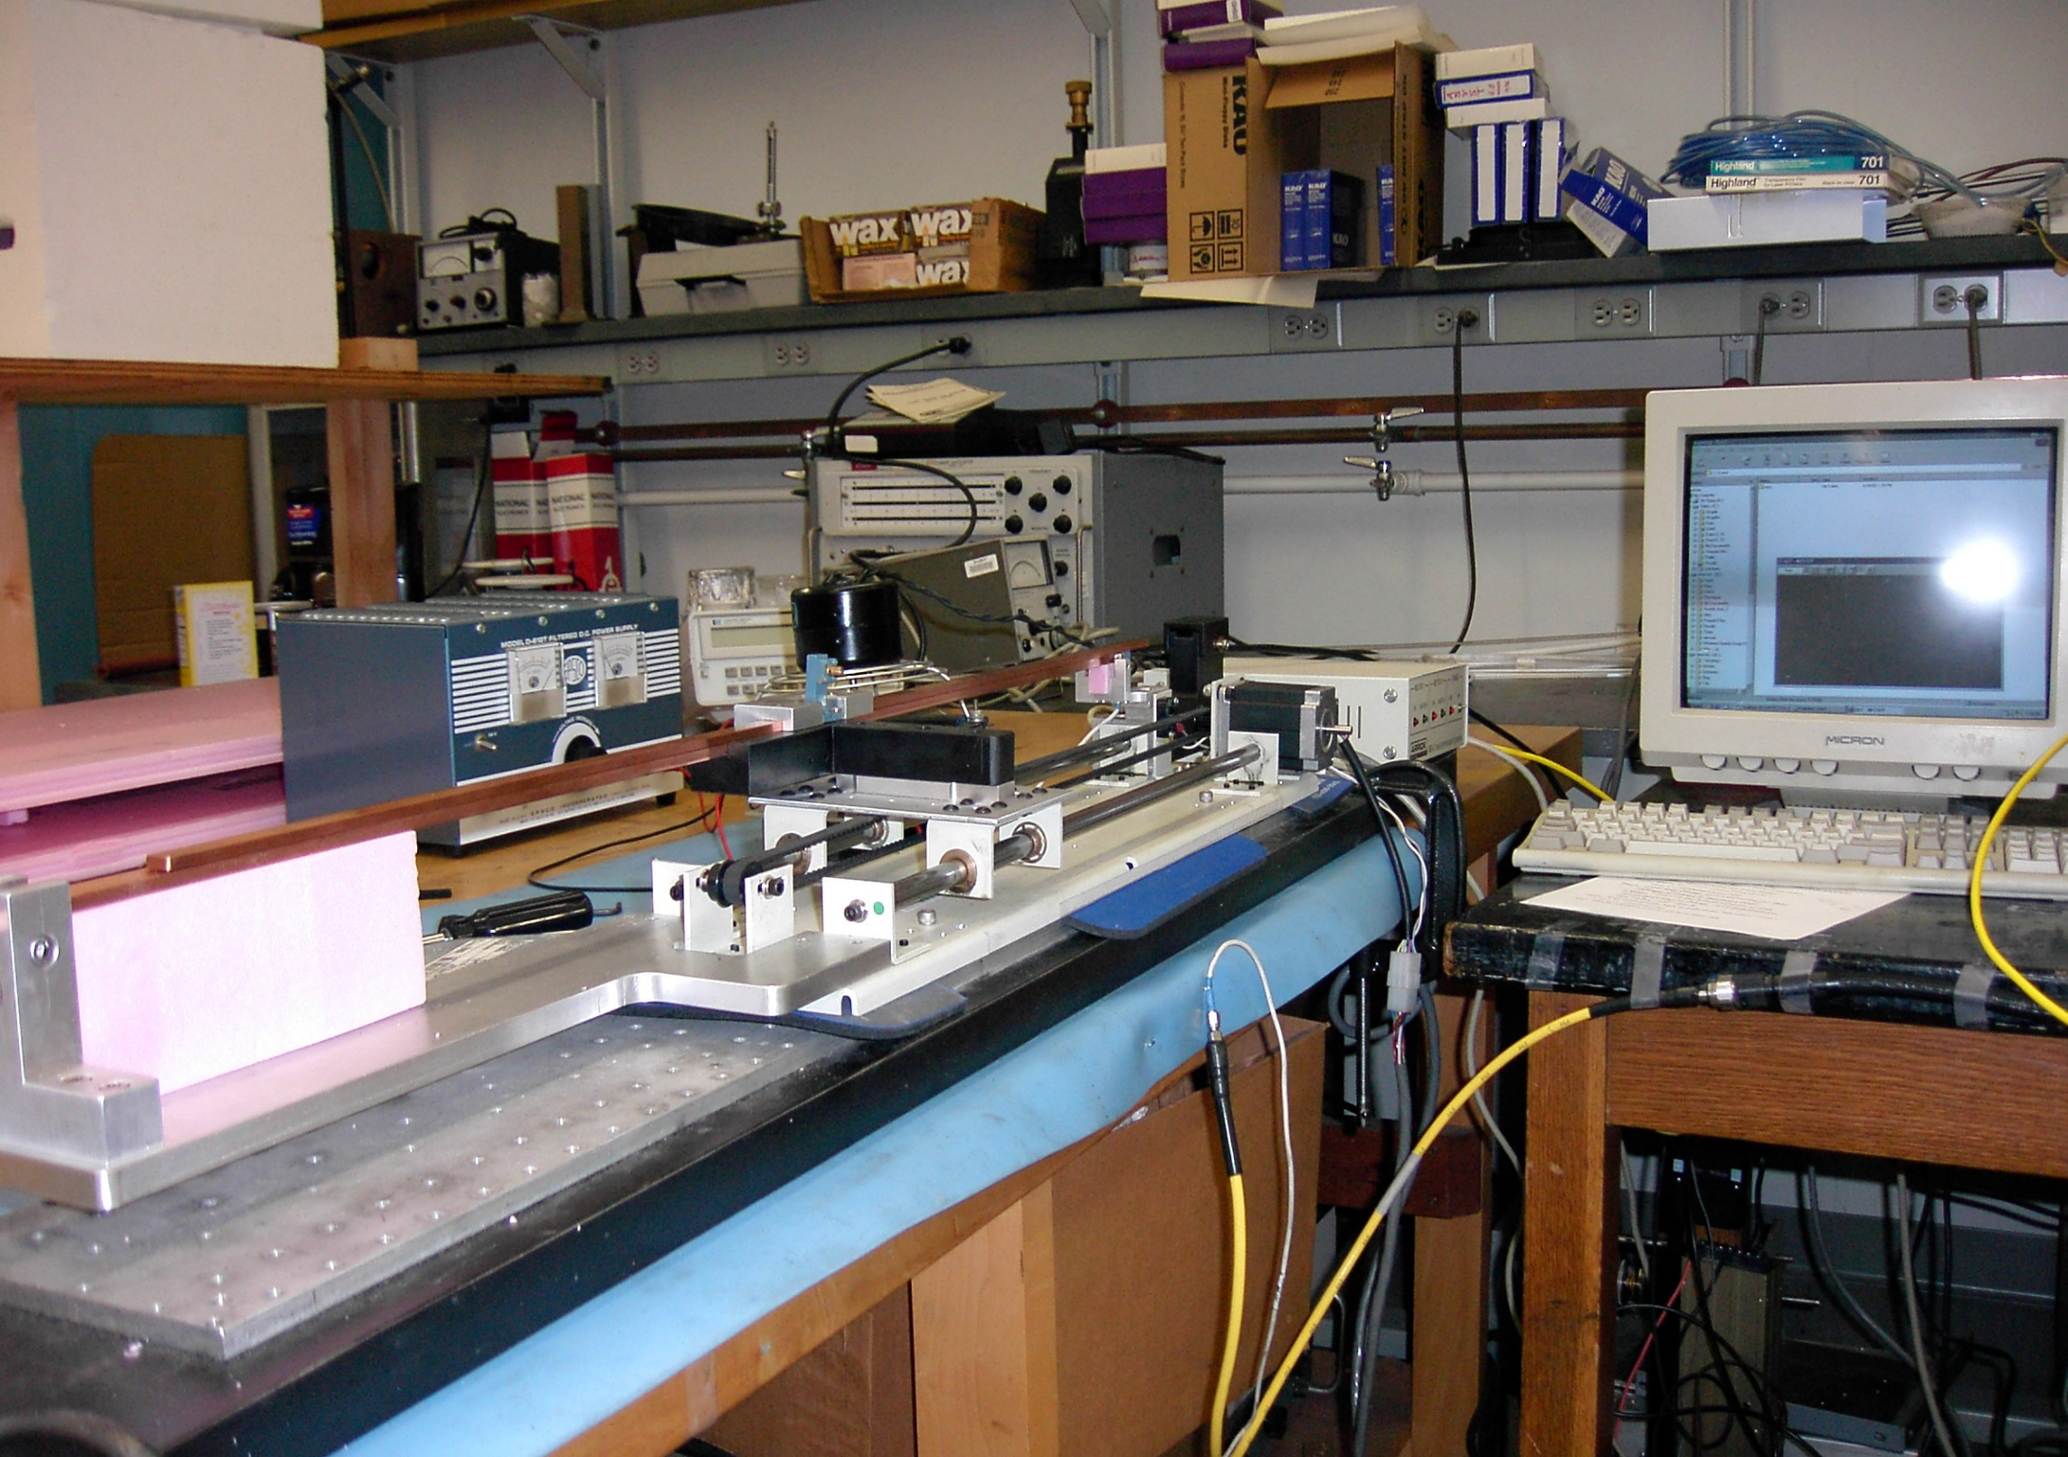

Slide 14
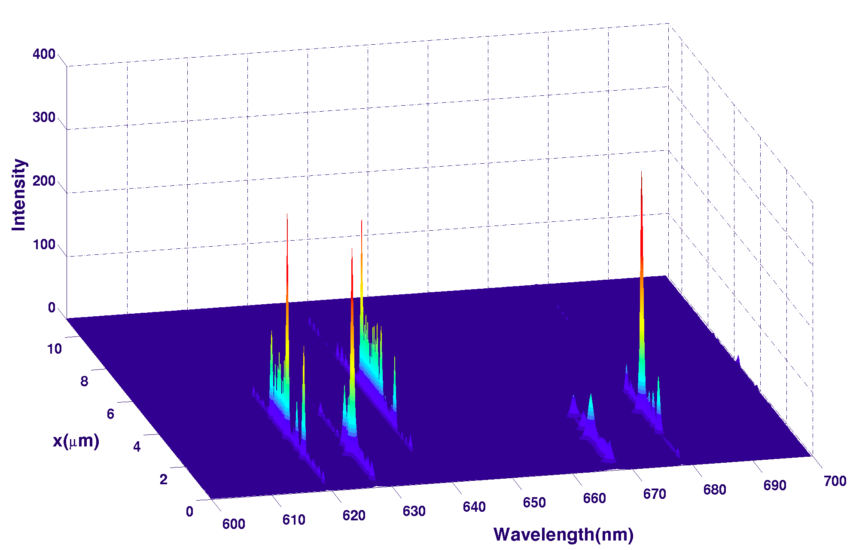
2mm slot

Slide 15
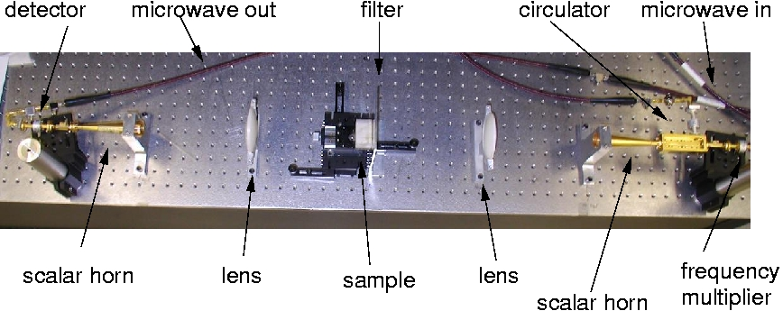

Slide 16
single-mode optical fiber
D_{i} ~8 mm
Bragg gratings
random lasing

Slide 17

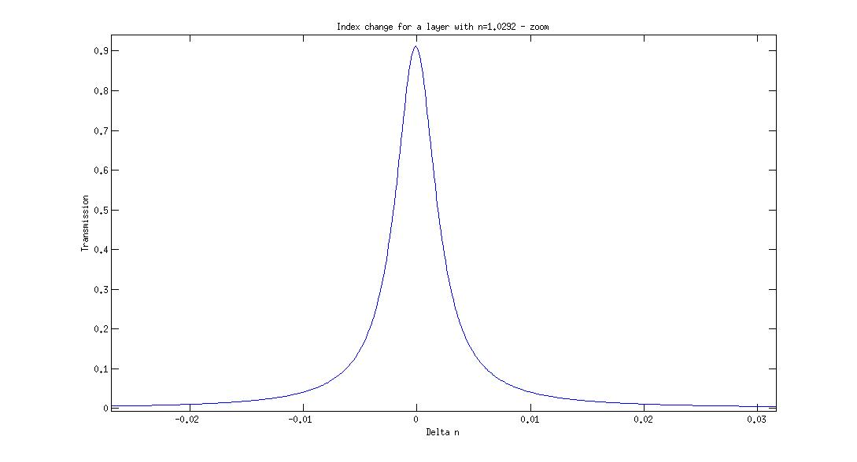
silicone
FIB

Slide 19
1941

Slide 22
transmission resonances vs eigenmodes

Slide 23
two types of QNM: ordinary and hidden

Slide 24
ordinary vs hidden

Slide 25
ordinary vs hidden
ballistic
ballistic
localization

Slide 28
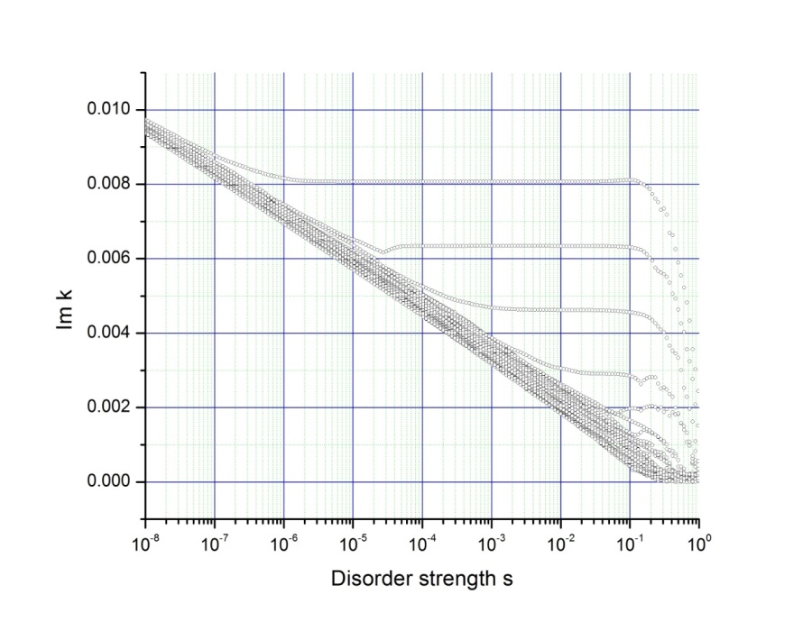
in 1-D disordered systems in ballistic and pre-localization regimes, two types of QNM exist: ordinary and hidden. Unlike ordinary, the hidden modes: are not associated with TRs; do not exhibit peaks of the intensity within the sample; their life-time is independent of the strength of disorder or even goes down when the disorder increases

Slide 29
quasi -1D random systems
ordinary and hidden

Slide 30
electron systems
wire coupled to leads
tight-binding model
ordinary and hidden

Slide 32
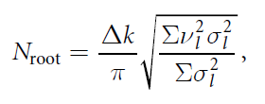

analytical calculations, weak scattering
BULLETIN OF THE AMERICAN MATHEMATICAL SOCIETY 32, 1995, p. 1 - 37
ALAN EDELMAN AND ERIC KOSTLAN
HOW MANY ZEROS OF A RANDOM POLYNOMIAL ARE REAL?
7.2. A random polynomial with a simple answer

Slide 34
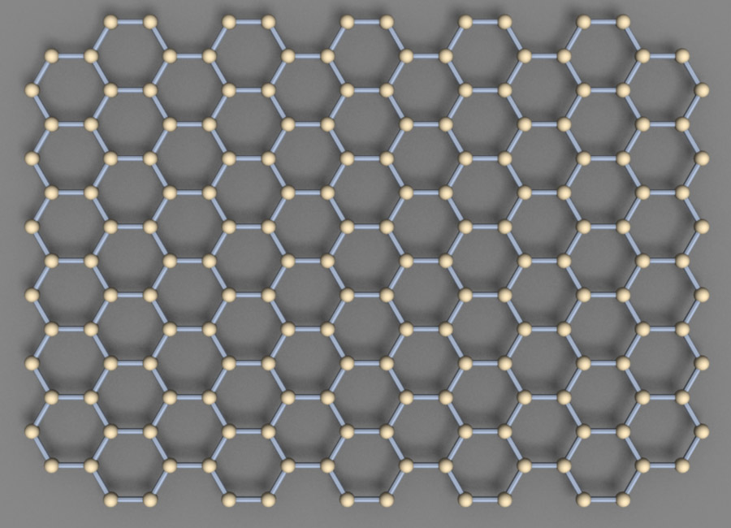
Localization of electrons in disordered graphene super-lattices
four valent electrons
3+1
tight-binding Hamiltonian

Slide 35
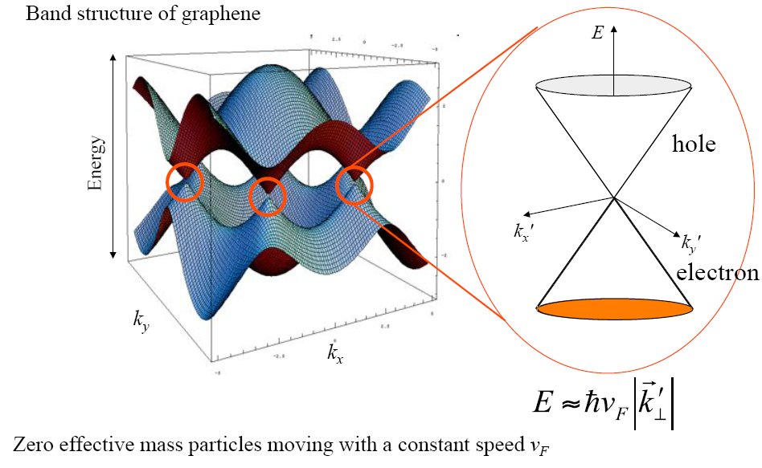
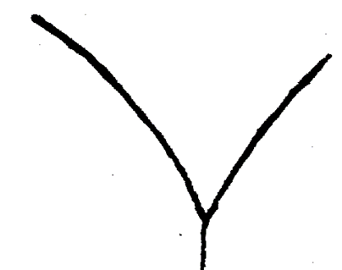
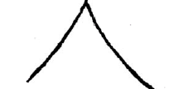
1947
Wallace
2004
Dirac points – point-like transparency zones

Slide 36
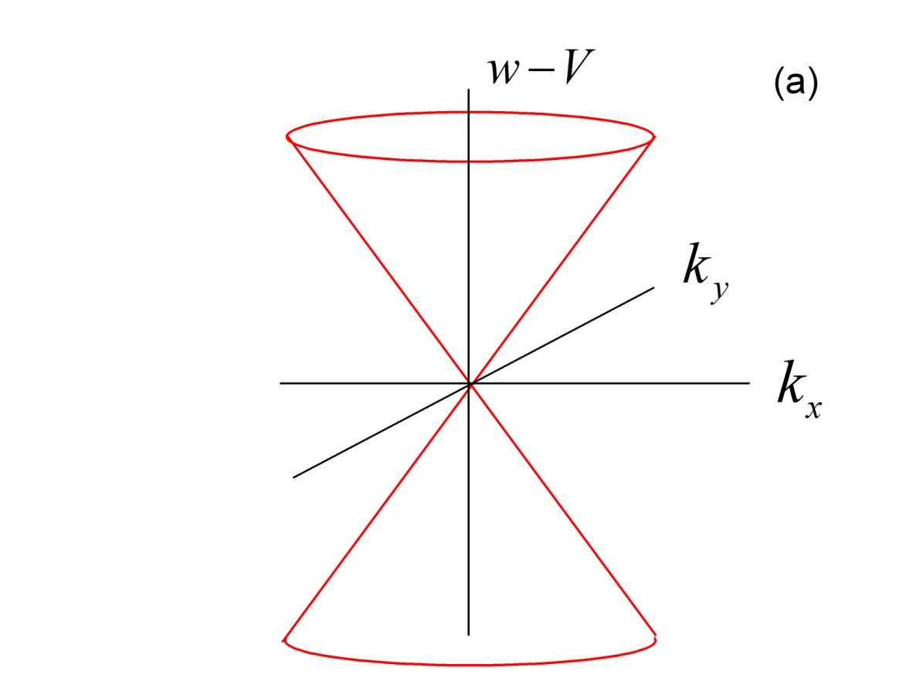
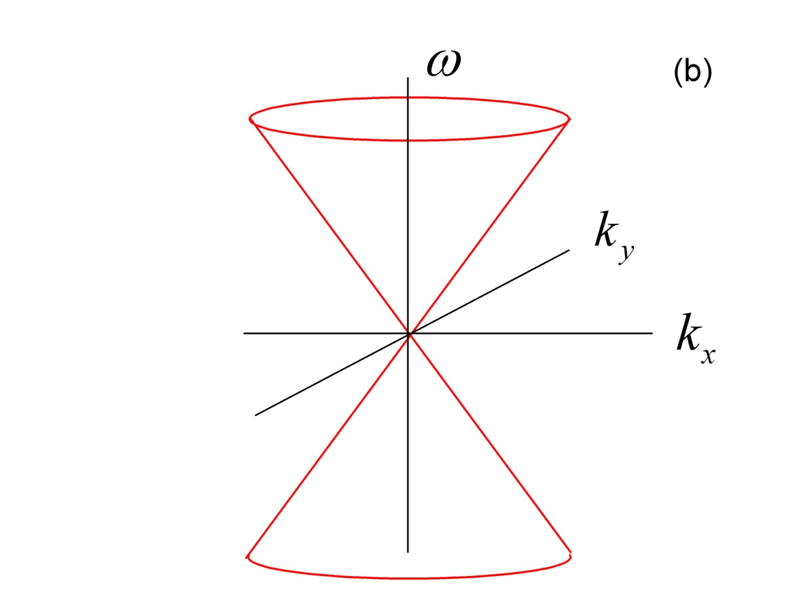
Dirac point
W-V
Dirac electrons
photon
photon
holes
is its own antiparticle

Slide 37
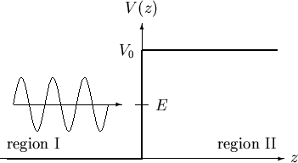
Klein paradox
quantum field theory: …particle – antiparticle pairs in the potential

Slide 38
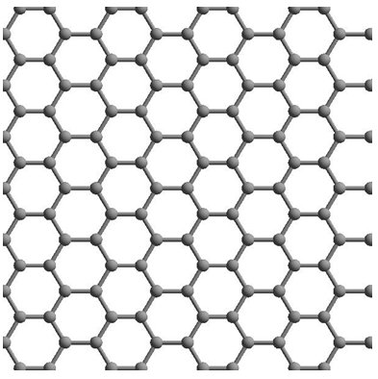
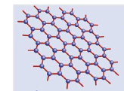
_

Slide 39
Randomly layered graphene super-lattice
no localization in 1-d random graphene super-lattice, no matter how strong the disorder is

Slide 40
Dirac equation for massless relativistic particles
Maxwell equations for electromagnetic waves
L. Silberstein, Ann. Phys. 22, 579 (1907)

Slide 42
Quasiparticles with the energy
in the graphene sheet subjected
to the electrostatic potential
Electromagnetic waves with the frequency
in the dielectric with the refractive index

Slide 43
boundary conditions

Slide 44
p-p, n-n, p-n
junctions

Slide 45
Klein paradox
matching microwave elements
quantum field theory: …particle – antiparticle pairs in the potential

Slide 46


Slide 47
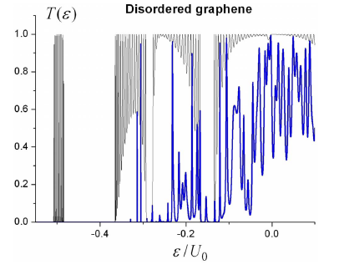
?
time-reversal symmetry?

Slide 48
ALTERNATING LAYERS OF NORMAL – META DIELECTRICS
“geometrical” disorder
the sample is transparent
no matter how strong the disorder is

Slide 49
monotype stack: N=10⁴
mixed stack: N=10⁴
suppressed localization

Slide 50
Resonances - single realization calculations
N=10³
“Homogeneous” stack
Mixed stack
Strong long-λ resonances in H-stacks almost completely disappear in M-stacks

Slide 51

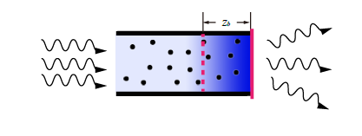

quasi-one-dimensional disordered systems
The basketball flies in a parabola, exhibiting perfect symmetry
but you get scores only when it is interrupted by a basket Michael Jordan
asymmetry parameter

Slide 52
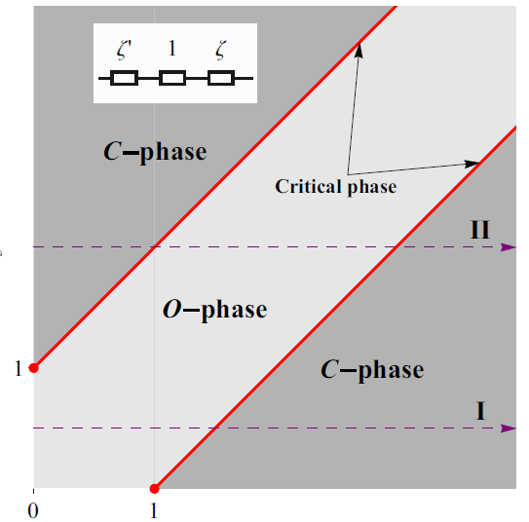
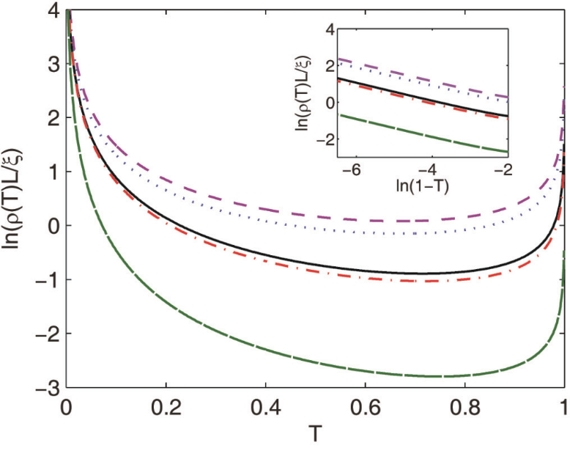
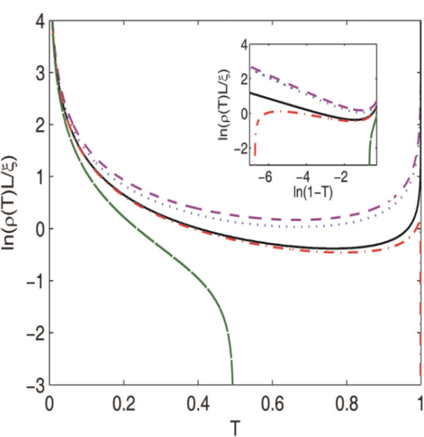

Slide 53
