Slide 1
Lecture 5

Slide 2
Small Perturbations; Local Perturbations; Smooth Perturbations; Geometrical optics; Path Integral
Feynman diagrams
Fokker-Plank Equation
Random Matrix Theory
Supersymmetry
Parabolic (paraxial) approximation

Slide 3
propagator

Slide 5
0

Slide 6
0

Slide 7
resonant Bragg scattering

Slide 8
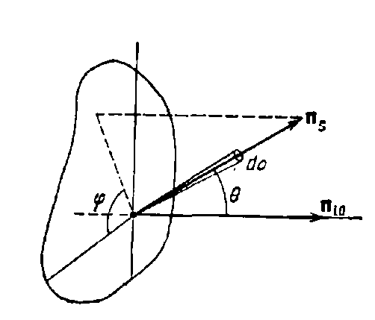
energy flux density
V
Differential SCS

Slide 9
Total SCS

Slide 10
Limits of validity of the single scattering (small perturbation) approximation
(Energy of the scattered field)
(Energy of the incident field)
weak scattering

Slide 11
energy conservation
Extinction Length

Slide 12
small perturbations
smooth perturbations
is not necessarily small

Slide 13
Geometrical Optics

Slide 14
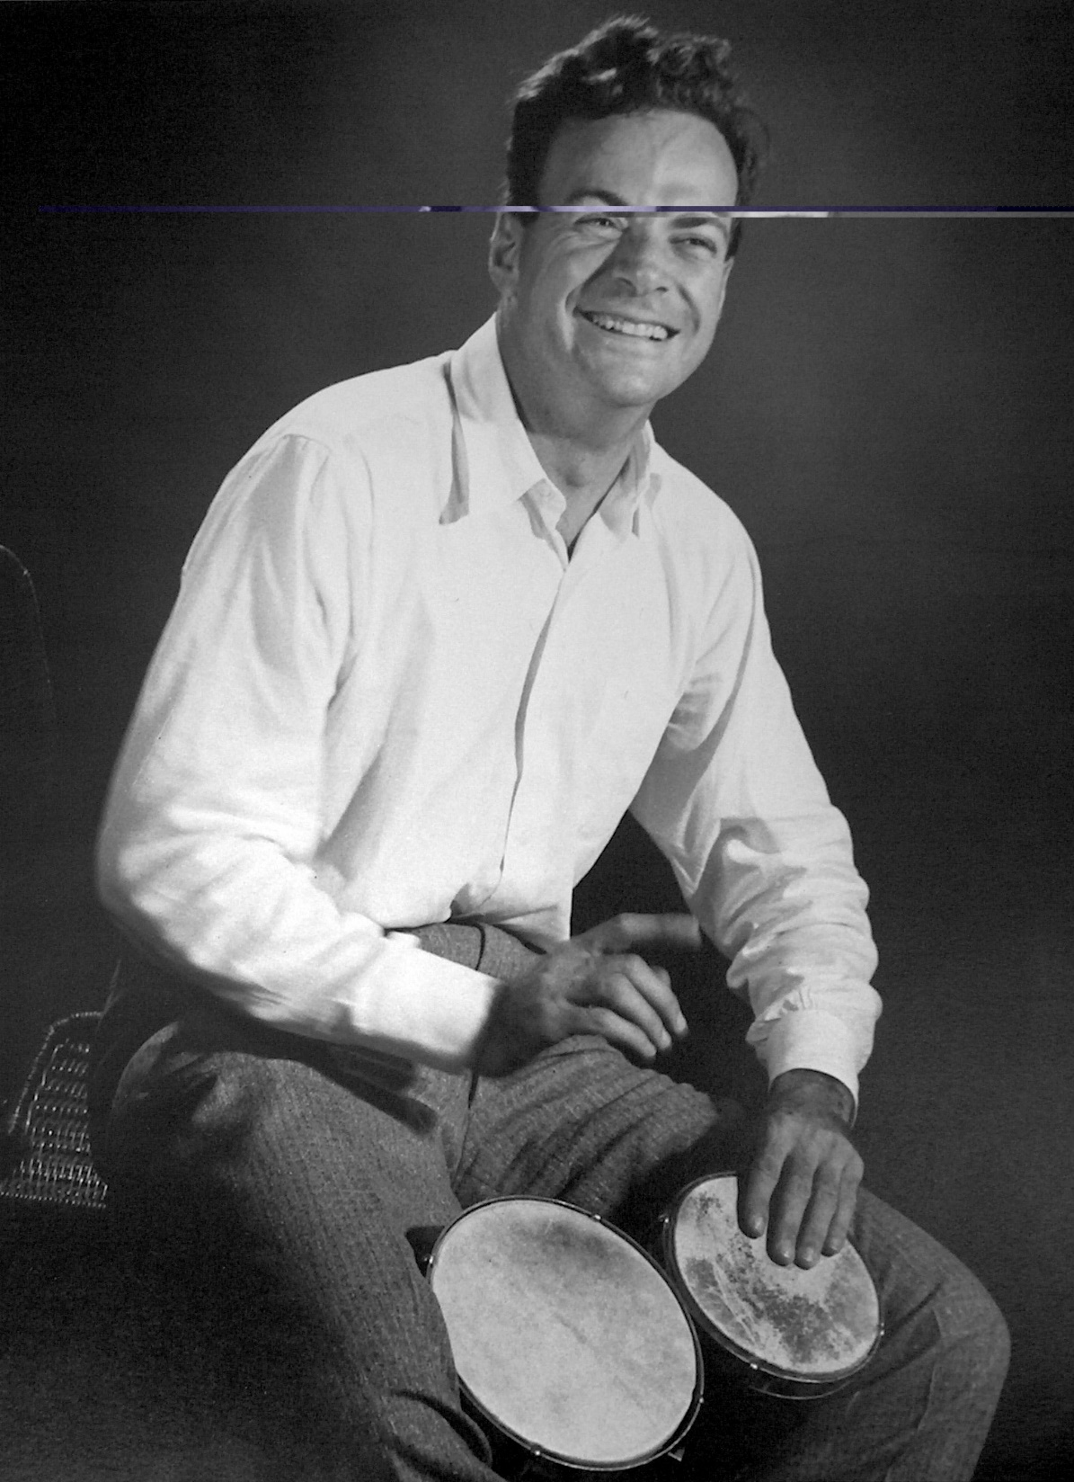

Slide 15
odd
even
Gaussian

Slide 19
Dyson Equation

Slide 21
WAVEGUIDE

Slide 22
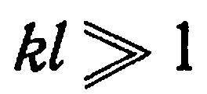

Slide 24
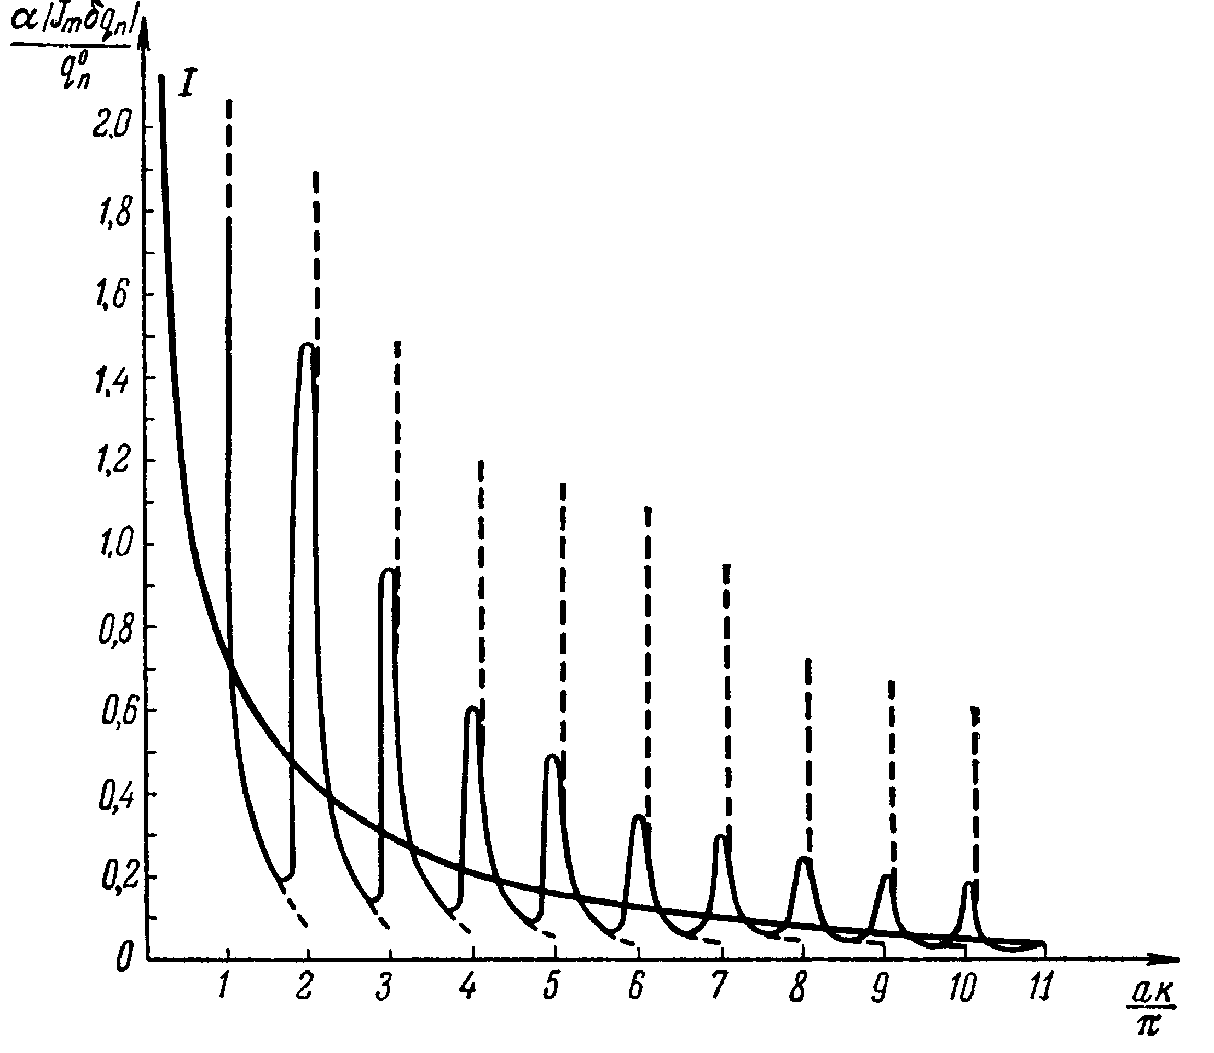

Slide 29
write analytical expressions for the diagrams
estimate the diagrams for the white-noise random process

Slide 30
Ladder diagrams

Slide 37
WAVEGUIDE

Slide 42
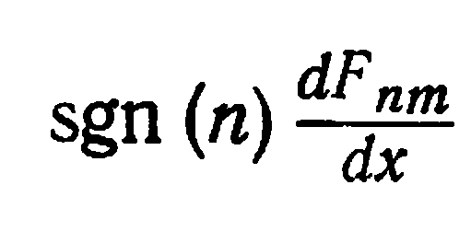
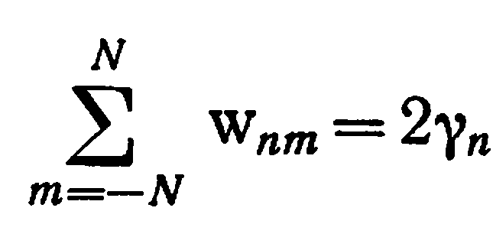

Slide 45
backscattered enhancement weak localization
interference
< >
RTE

